Slide 1
Sociology Research Center
Here is where your presentation begins

Slide 2
Contents of this template
You can delete this slide when you’re done editing the presentation
Fonts | To view this template correctly in PowerPoint, download and install the fonts we used
Used and alternative resources | An assortment of graphic resources that are suitable for use in this presentation
Thanks slide | You must keep it so that proper credits for our design are given
Colors | All the colors used in this presentation
Icons and infographic resources | These can be used in the template, and their size and color can be edited
Editable presentation theme | You can edit the master slides easily. For more info, click here
For more info:
SLIDESGO | BLOG | FAQs
You can visit our sister projects:
FREEPIK | FLATICON | STORYSET | WEPIK | VIDEVO

Slide 3
Table of contents
01
03
02
04
Our teaching method
The school’s teachers
You can describe the topic of the section here
You can describe the topic of the section here
Our academic areas
Enrollment process
You can describe the topic of the section here
You can describe the topic of the section here

Slide 4
Introduction
Mercury is the closest planet to the Sun and the smallest one in the Solar System—it’s only a bit larger than the Moon. The planet’s name has nothing to do with the liquid metal, since Mercury was named after a Roman god

Slide 5
—Someone Famous
“This is a quote, words full of wisdom that someone important said and can make the reader get inspired.”

Slide 6
Our teaching method
Methods
Activities
Goals
Feedback
Assessment
Mars is actually a very cold place
Mercury is the smallest planet
Venus has a beautiful name
Jupiter is the biggest planet

Slide 7
What sets us apart?
Mercury
Venus
Mars
Mercury is the closest planet to the Sun and the smallest of them all
Venus has a beautiful name and is the second planet from the Sun
Despite being red, Mars is actually a cold place. It’s full of iron oxide dust

Slide 8
The curriculum
Features
Introduction
Venus has a beautiful name and is the second planet from the Sun. It’s terribly hot, even hotter than Mercury
2XXX | Mercury is a small planet
2XXX | Earth is the planet with life
2XXX | Mars was named after a god
2XXX | Jupiter is the biggest planet
Venus
Earth is the beautiful planet where we all live on
Mercury
Despite being red, Mars is actually a cold place
Advantages
25%
50%
75%
Pluto
Ceres
Earth

Slide 9
Our academic areas
Mars
Venus
Neptune
Despite being red, Mars is actually a cold place
Venus is the second planet from the Sun
Neptune is the farthest planet from the Sun
Mercury
Saturn
Jupiter
Mercury is the closest planet to the Sun
Saturn is a gas giant with several rings
Jupiter is the biggest planet of them all

Slide 10
Our mission and vision
Mission
Vision
Mercury is the closest planet to the Sun and the smallest one in the Solar System—it’s only a bit larger than the Moon
Venus has a beautiful name and is the second planet from the Sun. It’s hot and has a poisonous atmosphere

Slide 11
Our values
Mars
Neptune
Mercury is the closest planet to the Sun and the smallest of them all
Venus has a beautiful name and is the second planet from the Sun
Jupiter
Saturn
Despite being red, Mars is actually a cold place. It's full of iron oxide dust
It's also the fourth-largest object by diameter in the Solar System

Slide 12
Our success
25%
50%
75%
Mercury
Venus
Mars
Mercury is the closest planet to the Sun and the smallest of them all
Venus has a beautiful name and is the second planet from the Sun
Despite being red, Mars is actually a cold place. It’s full of iron oxide dust

Slide 13
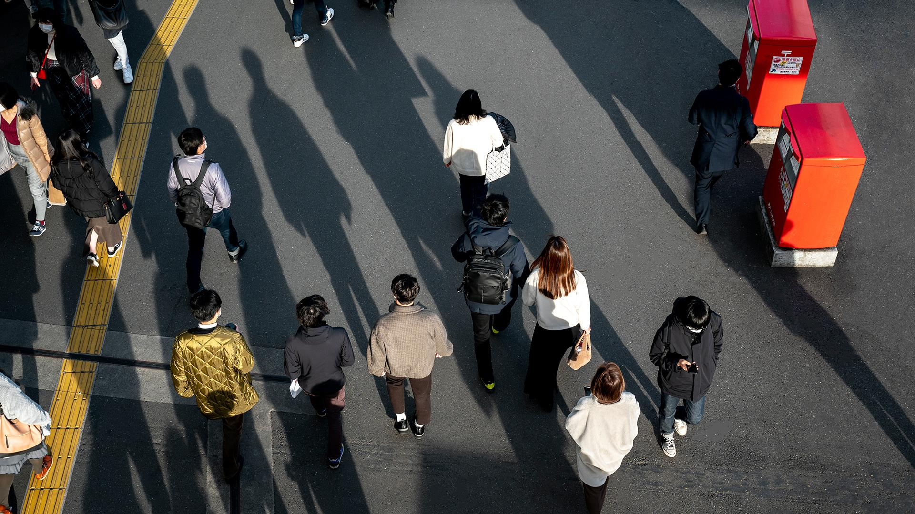
A picture always reinforces the concept
Images reveal large amounts of data, so remember: use an image instead of a long text. Your audience will appreciate it

Slide 14
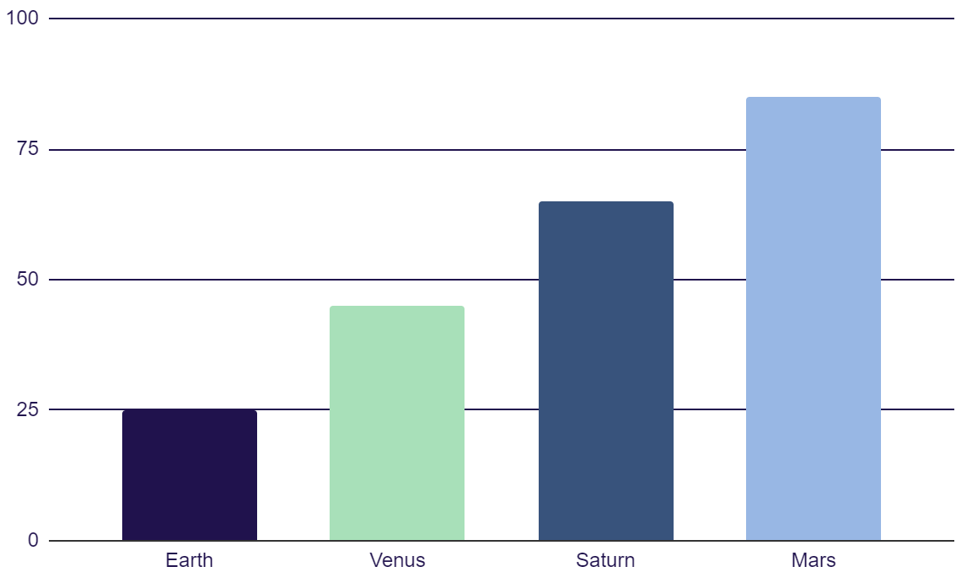
Statistics
Earth
Venus
Earth is the third planet from the Sun
Venus is the second planet from the Sun
Saturn
Mars
Saturn was named after a Roman god
Despite being red, Mars is a cold place
Follow the link in the graph to modify its data and then paste the new one here. For more info, click here

Slide 15



Our teachers
Kaliyah Harris
Timmy Jimmy
Sofia Hill
You can speak a bit about this person here
You can speak a bit about this person here
You can speak a bit about this person here

Slide 16
Our goals
1xxx
2xxx
2xxx
Earth is the third planet from the Sun
Venus is the second planet from the Sun
Mars is actually a very cold place
2xxx
2xxx
Jupiter is the biggest planet of them all
Neptune is very far away from the Sun

Slide 17
450.000
Big numbers catch your audience’s attention

Slide 18
Student progress
Mercury
Venus
Mercury is the closest planet to the Sun
Venus is the second planet from the Sun
1st term
3rd term
Saturn
2nd term
Mars
4th term
Saturn is a gas giant and has several rings
Despite being red, it’s actually a cold place

Slide 19
Enrollment process
01
02
Venus has a beautiful name and is the second planet from the Sun
Neptune is the fourth-largest planet in the Solar System
03
04
05
Despite being red, Mars is actually a cold place. It's full of iron oxide dust
Mercury is the closest planet to the Sun and the smallest of them all
Jupiter is a gas giant and the biggest planet in the Solar System

Slide 20
This is a map
Jupiter
It’s the biggest planet in the Solar System
Saturn
Saturn is a gas giant and has several rings
Mars
Despite being red, Mars is a cold place

Slide 21
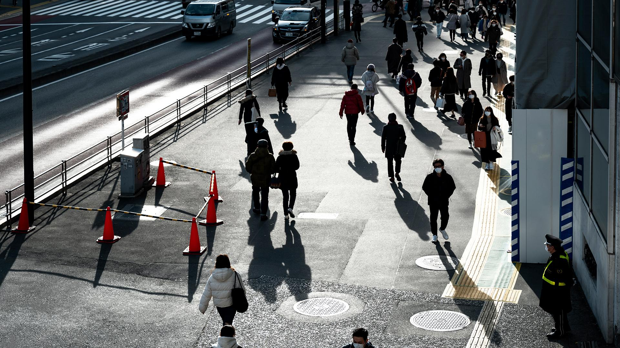
Special reminders
Do you know what helps you make your point clear?
Lists like this one:
They’re simple
You can organize your ideas clearly
You’ll never forget to buy milk!
And the most important thing: the audience won’t miss the point of your presentation

Slide 22

Product demo
You can replace the image on the screen with your own work. Just right-click on it and select “Replace image”

Slide 23
Thanks!
Do you have any questions?
youremail@freepik.com
+34 654 321 432
yourwebsite.com
CREDITS: This presentation template was created by Slidesgo, and includes icons by Flaticon, and infographics & images by Freepik
Please keep this slide for attribution

